Slide 1
MODIFIED QUAKE CASTER MODEL
PRESENTED BY - ANKIT YADAV
ANUBHAV JAIN
BIKASH KUMAR MALLICK
GOPAL JI GUPTA

Slide 2
CONTENT
EARTHQUAKE
QUAKE CASTER MODEL
AIM
MODIFICATIONS IN OUR MODEL
MODEL DESIGN
MODEL WORKING
SUMMARY

Slide 3
Earthquake
An earthquake (also known as a quake, tremor or temblor) is the shaking of the surface of the Earth resulting from a sudden release of energy in the Earth’s lithosphere that creates seismic waves.
Once the fault has locked, continued relative motion between the plates leads to increasing stress and, therefore, stored strain energy in the volume around the fault surface.
This continues until the stress has risen sufficiently to break through the asperity, suddenly allowing sliding over the locked portion of the fault, releasing the stored energy.
This process of gradual build-up of strain and stress punctuated by occasional sudden earthquake failure is referred to as the elastic-rebound theory.

Slide 4
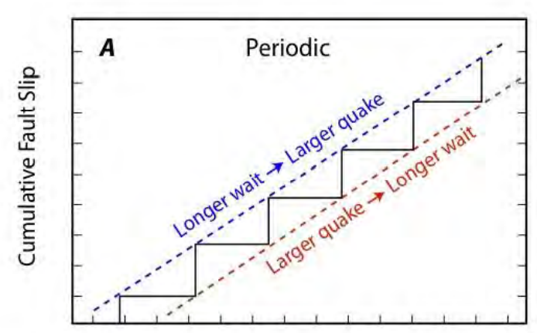
Hypothesis
Hypothesis 1: Earthquakes are periodic: This means that the same amount of fault slip is separated by the same amount of time. There is some evidence for this, particularly in the study of the data of very small earthquakes on creeping faults

Slide 5
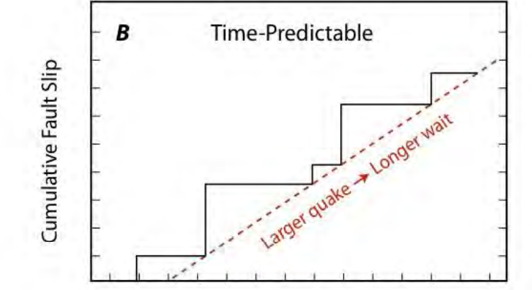
CONTINUE…
Hypothesis 2: - Earthquakes are time-predictable: This means that the larger the amount of fault slip in the last earthquake, the longer the time until the next earthquake. Another way of stating this hypothesis is that earthquakes occur when the failure stress is reached. This means that when a certain amount of stress accumulates along a fault, an earthquake will occur.

Slide 6
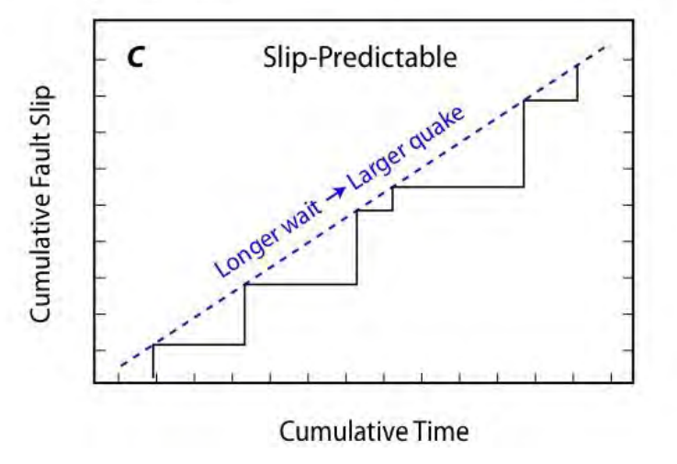
CONTINUE…
Hypothesis 3: Earthquakes are slip-predictable: This means that the longer the time stress accumulates, the greater the amount of fault slip in the next earthquake. Another way of stating this hypothesis is that earthquakes decrease the 3 amount of stress along a fault to a fixed minimum or to a background amount.

Slide 7
CONTINUE…
Hypothesis 4: Earthquakes occur randomly and have randomly varying size: This 'Poisson' hypothesis is also widely used, particularly when little information about a fault and its past earthquakes is available.
Can earthquakes be predicted??
Scientists are a long way from being able to predict earthquakes. Small earthquakes, called fore-shocks, always occur a few days before a major earthquake. As stress builds up in rocks before an earthquake, the ground may start to tilt. Seismographs record only the surface waves generated by an earthquakes.

Slide 8
QUAKE CASTER
QuakeCaster is an interactive, hands-on teaching model that simulates earthquakes and their interactions along a plate-boundary fault. QuakeCaster contains the minimum number of physical processes needed to demonstrate most observable earthquake features.
A granite slider in frictional contact with a nonskid rock-like surface simulates a fault at a plate boundary. A rubber band connecting the line to the slider simulates the elastic character of the Earth’s crust.
By stacking and unstacking sliders and cranking in the winch, one can see the results of changing the shear stress and the clamping stress on a fault. By placing sliders in series with rubber bands between them, one can simulate the interaction of earthquakes along a fault, such as cascading or toggling shocks.

Slide 9
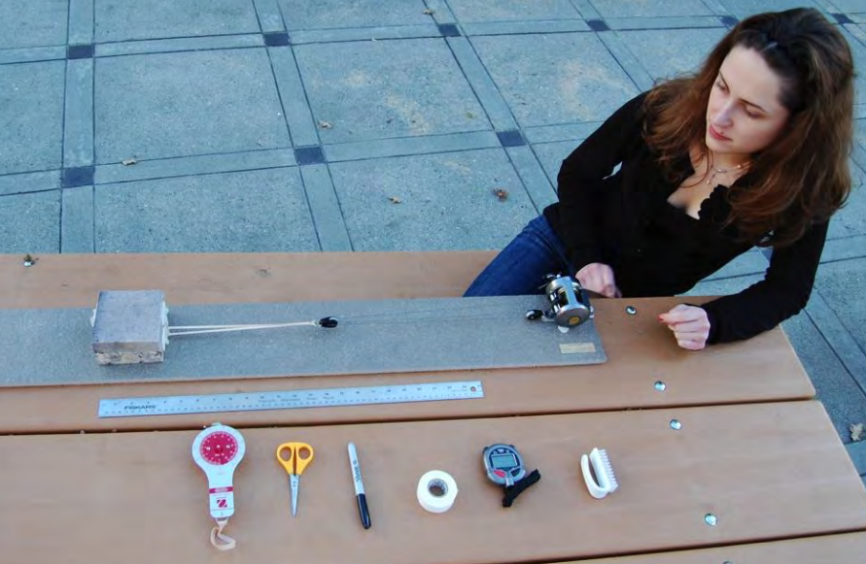

Slide 10
CONTINUE…
By inserting a load scale into the line, one can measure the stress acting on the fault throughout the earthquake cycle. As observed for real earthquakes, QuakeCaster events are not periodic, time-predictable, or slip-predictable. QuakeCaster produces rare but unreliable “foreshocks.”
When fault gouge builds up, the friction goes to zero and fault creep is seen without large quakes.
QuakeCaster events produce very small amounts of fault gouge that strongly alter its behavior, resulting in smaller, more frequent shocks as the gouge accumulates.

Slide 11
AIM
The problem with quake caster model is that it is unable to justify the hypothesis and unable to predict the earthquake.
so our aim is to justify these hypothesis and predict the earthquake more efficiently with modified quake caster model.

Slide 12
Modification in Quake Caster Model :
Changes in Slider Blocks.
Changes in Rubber band ( Dimension and Elasticity).
Changes in Pulley System
Changes in Force applying Mechanism.

Slide 13
Changes in Slider Blocks:
It doesn’t represent the true lithology of the earthquake area. So, we modify three things
No. of block
Types of blocks
Arrangement of block
We have modified three block into five block.
We have used five different types(material) of block
Blocks are arranged lithostatic graphical.

Slide 14
Changes in Rubber band (Dimension and Elasticity):
We are using more stiffer rubber band in compare to original quake caster model. as we have higher load(blocks).
Changes in Pulley System:
We are using 6 pulley system because higher load and a greater number of blocks.
Changes in Force applying Mechanism:
We are replacing hand rotation mechanism to the Electric motor.

Slide 15
Model Design:
Parts and Equipment required for this Model :
Corvalus 300 fishing reel
Drill, screws
2 small pieces of rubber
6 pulleys
White electrical tape
Marker
Pelican case
Extra foam for Pelican case
5 sliders (Granite, Shale , Sandstone , Clay , Pebbles)
48×6-inch plastic board (foamed PVC ⅛ inch thick)
Sandpaper
4 photo clips
Ruler
Marking tape
Marine Adhesive Sealant

Slide 16
Electric Motor (Force applying Mechanism)
Thin metal wire
Cork
X-Acto knife
Spray-on adhesive
Size 74 rubber bands
Force (stress gauge)
Stopwatch
Small brush

Slide 17
Steps for Design:
Take sliders three should be approximately 4×4 inches, two should be 2X2 inches and around 1¼ inch thick and PVC plastic board to desired length of size is 48×6 inches , ⅛ inch thick.
Using the spray adhesive, adhere sandpaper to one side of the plastic board then glue the sandpaper backing directly to the board so it can be removed and replaced easily.
Now with Slider, use sandpaper to roughen the backs of 2 photo clips and by ruler mark the center of on both side of a slider. Use big dollop of Marine Adhesive Sealant on the back of one photo clip. Attach it to the center of one slider’s side. Let dry.
The rough side of the slider should be sandblasted to increase the friction with the sandpaper.
Now, we use Electric Motor for applying forces in Blocks.

Slide 18
CONTINUE…
Attach fishing reel to foam board, measure the furthest distance the reel can be placed from the tile edge. Put two more screws at the front edges of the track to ensure the track will not wiggle side to side.
Set up pulley system to alleviate the weight using electric motor, glue three of the kite pulleys together using strong adhesive . Use a C-clamp to hold them in position.
Before attaching the wire to the screw, add a pulley to the wire. Thread the spectra through the pulley. Spectra is a low-stretch line. It is braided filaments of high-modulus material.
Add a layer of cork to the bottom of the nonskid-covered foam board, using an X-Acto knife, cut around the edges. Spray one side of the cork with spray-on adhesive and attach the cork to bottom of nonskid-covered foam board.
Attach a size 74 rubber band to a photo clip on a granite slider. Attach the Ohaus scale to the other end of the rubber band. Link the scale with the pulley.

Slide 19
WORKING OF MODEL
Pebbles
Clay
Sandstone
Shale
Granite

Slide 20
DISCUSSION
Earthquakes are dangerous to human life and the infrastructure build by them.
There are some models which attempted to test the hypothesis but failed.
We modified quake caster model with the actual lithostratigraphy of Parkfield area.
Our model is a modified attempt to test the earthquake hypothesis and will solve the prediction problem.
We hope you liked our modified model.
Please allocate the fund ...

Slide 21
THANK YOU

